Slide 1


University of Basrah
Al-Zahraa Medical College
Ministry of higher Education and Scientific Research
Academic year 2023-2024
5th year
REPRODUCTIVE BLOCK
Lecture
Duration : 20 minutes
Intrauterine death
Presented by
Dr. ABD ALKAREEM HUSSEIN SUBBER
Block staff:
Dr.Marwa Sadik (module leader)
Dr. Abdal kareem Hussain Subber
Dr.Alaa Hufdhi
References: Self Assessment & Review obstetrics edd by SAKSHI ARORA HANS ; Obstetrics by 10 teachears , Dewhurst’s Textbook of Obstetrics & Gynaecology 2018 and Internate

Slide 2
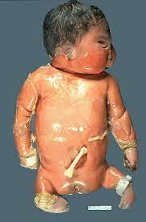

University of Basrah
Al-Zahraa Medical College
Ministry of higher Education and Scientific Research
LEARNING OBJECTIVES
Identify the etiology of intrauterine fetal death (stillbirth).
Review the appropriate evaluation of stillbirth.
Outline the management options available for stillbirth.

Slide 3
University of Basrah
Al-Zahraa Medical College
Ministry of higher Education and Scientific Research
Definition
Intrauterine fetal death ( stillbirth) is death of the fetus in utero after the period of viability (after 24 weeks) or when fetus weighs more than 500 gm. WHO is a baby born with no signs of life at or after 28 weeks’ gestation. It complicate 1% of pregnancies.
Causes:
1- Unexplained stillbirth is the most commonly reported cause, around 60 % of cases 2- Placental abnormalities : placental abruption, praevia, ; chorioangioma
3- Chronic fetal hypoxia in FGR may eventually lead to fetal acidaemia, both
respiratory and metabolic, which if prolonged can lead to intrauterine death
4- Maternal condition : DM ; hypertension ; Alpha thalassemia; Rh isoimmunization, APL syndrome. advanced age group ( chromosomal anomalies) ; postdate; Cholestasis
5- Birth defects
6- Obstructed labour, birth trauma and ruptured uterus
7- Polyhydramnios; oligohydramnios; Premature rupture of membranes
8- Umbilical cord accident ( prolapsed, constricting loop or knot )
9- Multiple gestation
10- Infection ( Escherichia coli, group B streptococcus; Listeria, CMV, parvovirus B19 , syphilis, Herpes, toxoplasmosis , HIV

Slide 4
University of Basrah
Al-Zahraa Medical College
Ministry of higher Education and Scientific Research
Physical Findings
General examination
weight; skin rashes; guarding and tenderness; symphysis fundal height; Fetal heart; vaginal bleeding and discharge.
CBC, glucose; torches; maternal hemoglobinopathy; Blood group and Rh; Test for APL syndrome; Urine for albumin
Laboratories investigations

Slide 5
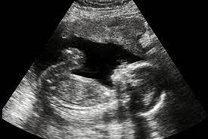
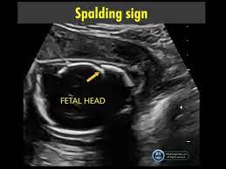
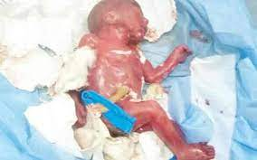

University of Basrah
Al-Zahraa Medical College
Ministry of higher Education and Scientific Research
Diagnosis of IUD
Clinical history: Associated maternal condition associated with intraparum stillbirth like preeclampsia, chorioamnionitis and placental abruption
IUD can be diagnosed clinically by
Fetal movements absent.
The size of the uterus less than the period of gestation.
Liquor decreased.
FHS absent by sonic aid or cardiotocography
Egg-shell crackling feel of the fetal head (late feature) by vaginal examination if women in labour with cervical dilatation .
Ultrasound: Earliest diagnosis is possible by real time USG reveals negative FH ; Spalding’s sign
Absence of heart beat and breath after delivery.

Slide 6
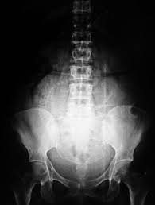
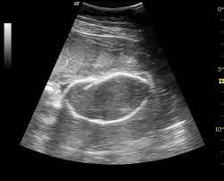
University of Basrah
Al-Zahraa Medical College
Ministry of higher Education and Scientific Research
Diagnostic features by ultrasound :
Absence of fetal cardiac activity on ultrasound scan (diagnostic).
Decreased liquor amnii., hydropes fetalis
Spalding’s sign i.e., overlapping of fetal skull bones due to shrinkage of cerebrum after fetal death.
((Spalding sign: It is the irregular overlapping of the cranial bones on one another, due to liquefaction of the brain matter and softening of the ligamentous structures supporting the vault; Appears 7 days after death .
It is evident on both ultrasound and radiology))

Slide 7

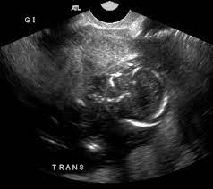
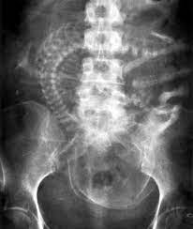
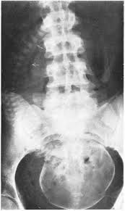
University of Basrah
Al-Zahraa Medical College
Ministry of higher Education and Scientific Research
Roberts sign: Presence of gas in the fetal large vessels(earliest sign-seen 12 hours after fetal death).
Ball sign: Crumpled up spine of the fetus or hyperflexion of the spine.
Spalding’s sign: Overlapping of fetal skull bones seen due to shrinkage of cerebrum after death of fetus.
Crowding of the ribs shadow with loss of normal parallelism.
Radiology:

Slide 8
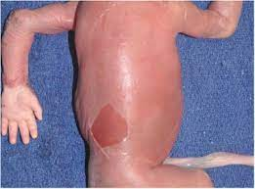
University of Basrah
Al-Zahraa Medical College
Ministry of higher Education and Scientific Research
Complications:
1-Haemorrhage and postpartum haemorrhage
2-Disseminated intravascular coagulation (The risk of DIC is 10% if the intra- uterine death occurred within 4 weeks and rises to 30% after 4 weeks.
3- Sepsis
4-Acute renal failure
5-Hysterectomy
6-Psychosocial stress
7-Maternal mortality

Slide 9
University of Basrah
Al-Zahraa Medical College
Ministry of higher Education and Scientific Research
Management:
1- Proper assessment of hematological situation (including platelet count, fibrinogen and coagulation studies,
2- In 80% cases of IUD, spontaneous expulsion occurs in 2 weeks. If spontaneous expulsion fails to occur within 2 weeks, intervention should be done; which indicated in
a. Psychological upset of the patient.
b. Manifestations of uterine infections.
c. Falling fibrinogen level (fibrinogen estimation should be done every week in case of IUD).
d. Tendency of prolongation of pregnancy beyond 2 weeks.
3- Labour can be induced by, vaginal misoprostol, oxytocin drip or PGE2 gel can be used to ripen the cervix or by 4- Foley's intracervical insertion
4- ARM should be not done; due to the risk of infection
6- Cesarean section with a dead fetus may sometimes be necessary in case of previous cesarean sections , placenta previa and transverse lie
7- Active management of third stage of labour
8- Lactation suppression by single dose of cabergoline (0.5 mg) or by bromocriptine (2.5 mg daily)
9- Psychological support.

Slide 10
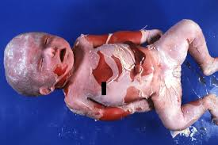
University of Basrah
Al-Zahraa Medical College
Ministry of higher Education and Scientific Research
Type of still birth
1- Macerated stillbirth: autolytic changes which occur when the fetus remains in utero after its demise. The earliest sign of maceration is skin slipping (epidermis separates from the dermis ) . It appears after 6-12 hrs. Latter sign is accumulation of fluid under the skin and formation of bullae which takes 24 hrs to occur.
2- fresh stillbirth . skin appearance and no signs of maceration at the time of delivery

Slide 11
University of Basrah
Al-Zahraa Medical College
Ministry of higher Education and Scientific Research
Follow‐ up investigations
1- Blood test (( renal function tests, liver function tests, RBS and HB1C, Blood group and Rh, TORCes and parvovirus B19, thrombophilia and antiphospholipid screening .
2- Cytogenetic and chromosomal analysis from samples taken at the time of postmortem
or from the placenta or cord at delivery [
3- Histopathological examination of the placenta
4- Ideally full post‐mortem examination

Slide 12
University of Basrah
Al-Zahraa Medical College
Ministry of higher Education and Scientific Research
Follow‐ up investigations
1- Blood test (( renal function tests, liver function tests, RBS and HB1C, Blood group and Rh, TORCes and parvovirus B19, thrombophilia and antiphospholipid screening .
2- Cytogenetic and chromosomal analysis from samples taken at the time of postmortem
or from the placenta or cord at delivery [
3- Histopathological examination of the placenta
4- Ideally full post‐mortem examination

Slide 13
University of Basrah
Al-Zahraa Medical College
Ministry of higher Education and Scientific Research
Management of Future Pregnancy
1- If medical problem is identified in the mother ( like DM, Hypothyroidism) medical consultation should be done to control it
2- Preconceptional counseling is helpful if congenital anomalies or
genetic abnormalities are found, including genetic screening
3- Increased fetal surveillance during the next pregnancy for reassuring
4- Antepartum fetal wellbeing stared from 28 wks of gestaion by kick counts, fundopubic
measure, frequent ultrasound, weekly biophysical profile,
5- Early intervention if no cause can be identified

